Slide 1
Looking into The Travel Insurance Industry
Using Python and Data Studio Visuals

Slide 2
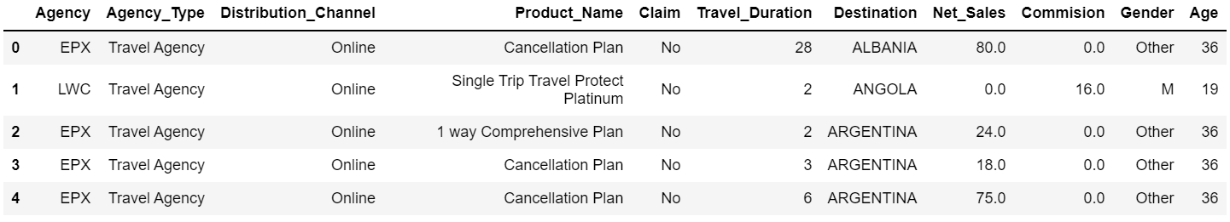
A preview of the Travel Insurance Table

Slide 3
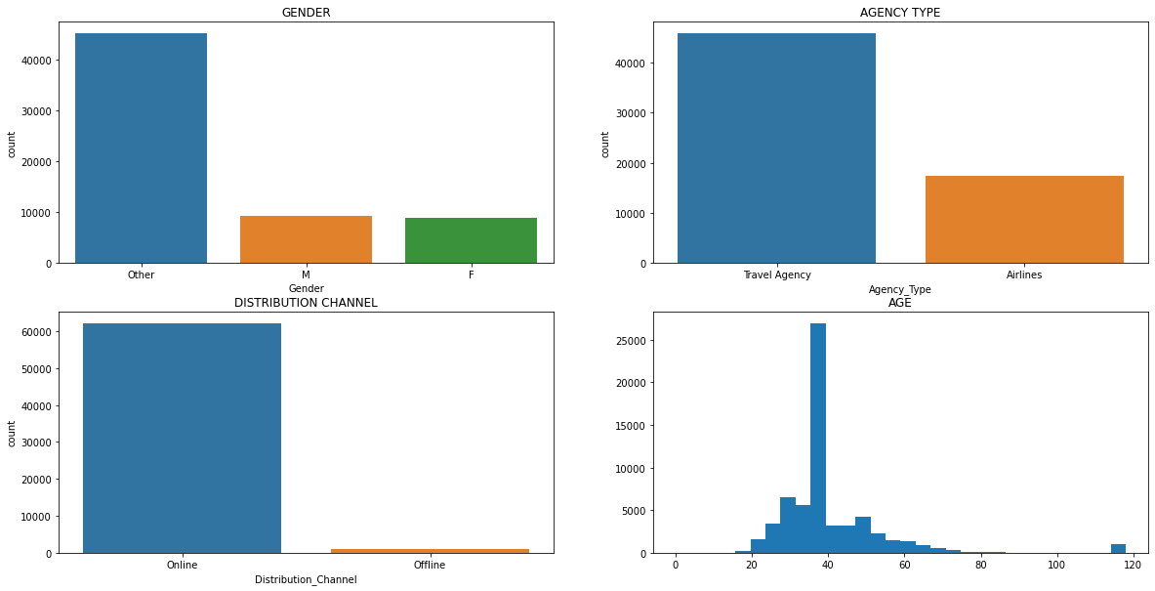
This shows the data distribution in the table

Slide 4
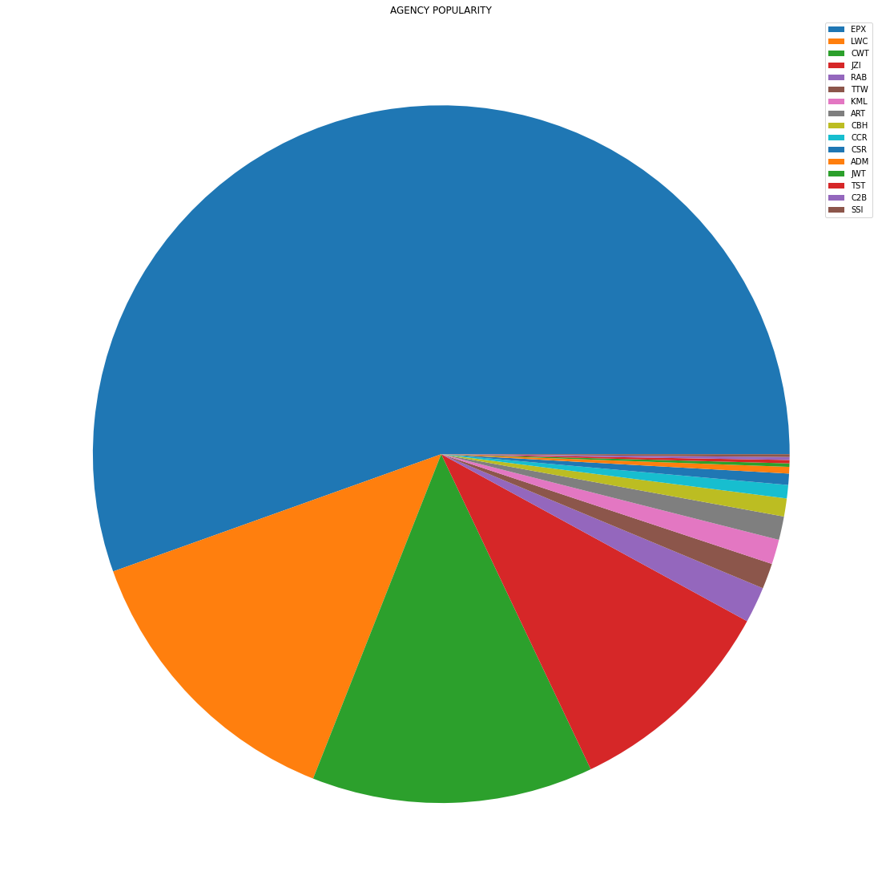

Agency Popularity
EPX Is The Most Used Agency
SSI is The Least Used Agency

Slide 5
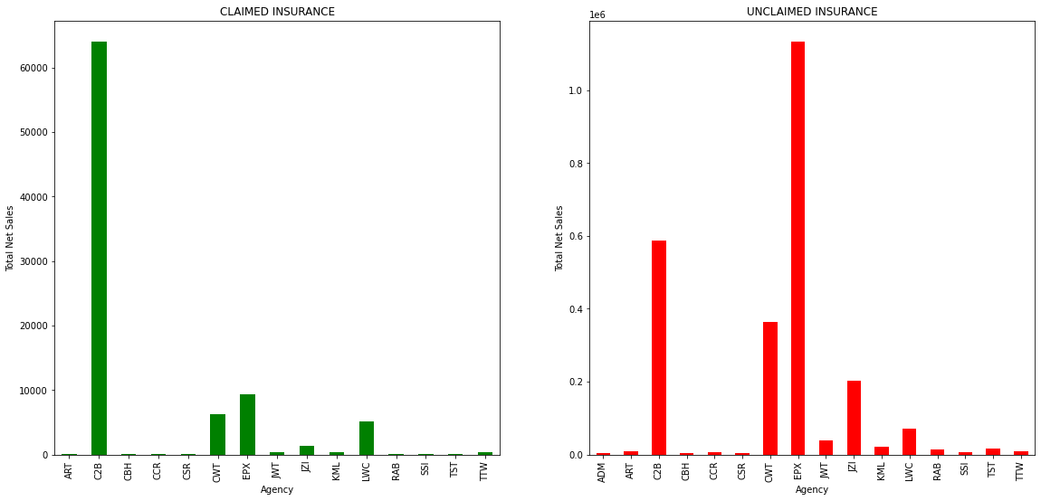
Claimed Vs Unclaimed Insurance: Total Sales for Each Agency

Slide 6
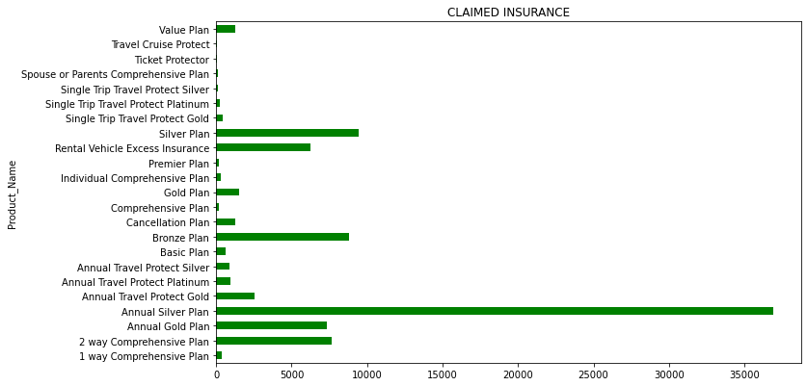
Total Sales Of Each Product

Slide 7
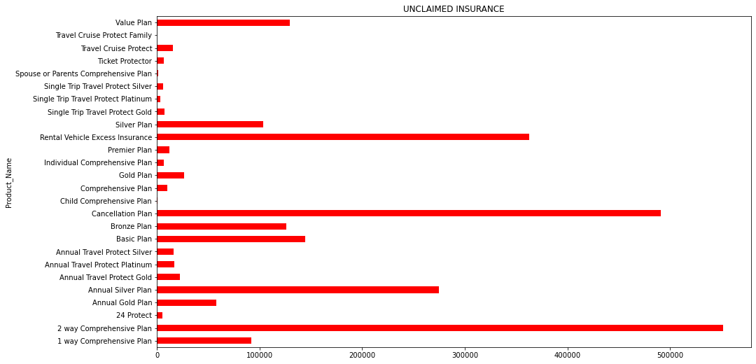
Total Sales Of Each Product

Slide 8
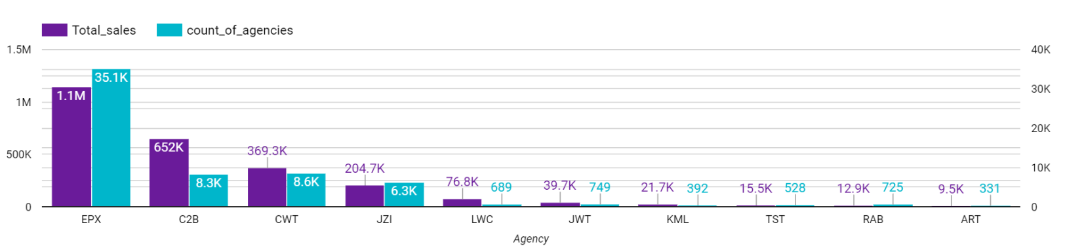
Sales Vs Agency

Slide 9
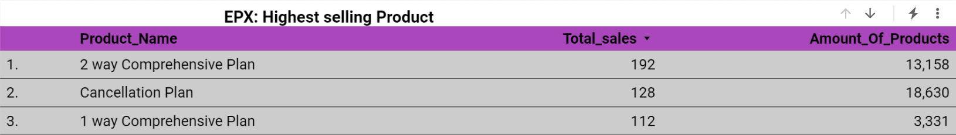
Further Look into EPX: The Highest Selling Agency

Slide 10
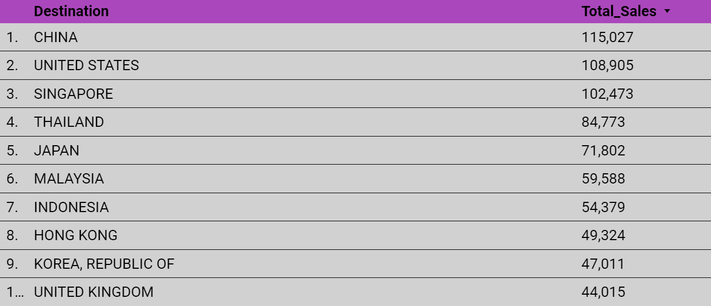
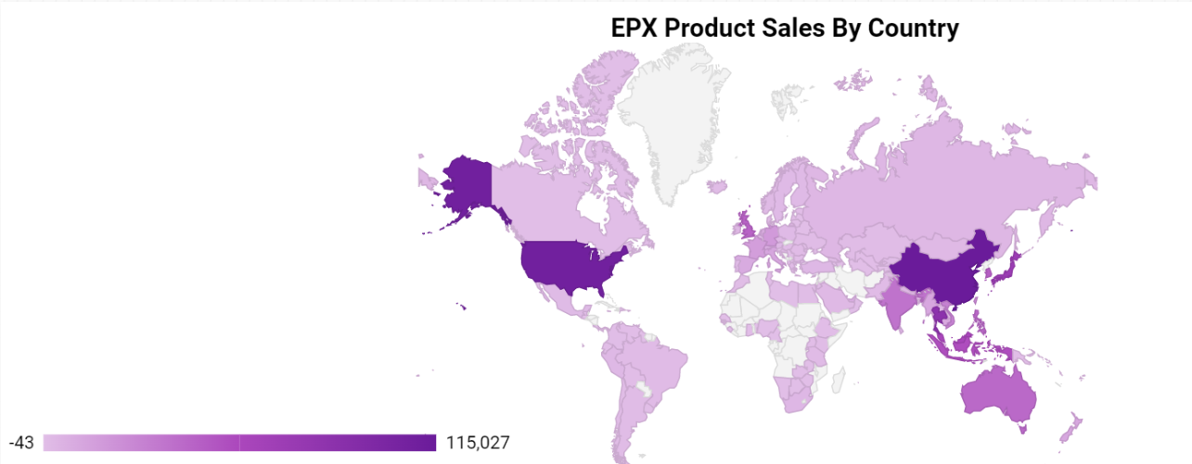
EPX Product Sales:

Slide 11
Conclusions
EPX is the most popular Agency with a record count of 35,100
EPX sold the most products with a Total Sale of $1.1 Million
China is the Favourite Travel Destination for people who use EPX
For Unclaimed Insurance C2B is the Highest Selling Agency
Customers preferred Distribution Channel is Online, not Offline
Customers preferred Agency Type is the Travel Agency , not the Airline Agency

